Slide 1
Lecture 22
Chemical Engineering for Micro/Nano Fabrication

Slide 2


Final Exam
When: Thursday December 13th from 9:00 am – Noon
Where: ETC 2.114
Bring Pencil, eraser....no calculator.
Corrected Exams will be available for you in NHB 5.136 after the grades are posted.

Slide 3
What to Review
Quizes
Midterm exams
Graduate Presentations
Vocabulary and acronym list
Extract basic principles from notes
  Relationships that connect variables such as wave length, slit width, gap, etc with resolution energy/photon, etc.
  What caused the “abandoned” processes to fail?
    What was learned from this??
  How do the various photoresist systems work?
What are the current strategies for manufacturing and what are the challenges with these technologies?
Study with a friend
Write a test
Come to visit and ask questions!!

Slide 4
Chemically Amplified Deep UV Resists
Photoacid Generation
with
acid
without
acid
Mass
hν
H⁺⁻SbF₆
S⁺⁻SbF₆
100
150
200
250
300
Temperature (°C)
Acid-Catalyzed Deprotection
CH₂
CH
CH₂
CH
n
n
H⁺
+
CO₂
Δ
OH
O
O
+
H⁺
+
CH₂=C
CH₃
protecting
group
O
CH₃

Slide 5
248 nm Resist Design Considerations
Dissolution by etching prevents swelling
Incorporates catalysis to achieve high sensitivity
Employs polyphotolysis for high contrast
Can be developed in either tone
High transparency for steep walls.
Aromatic polymer provides dry etch resistance
High activation energy provides storage stability

Slide 6
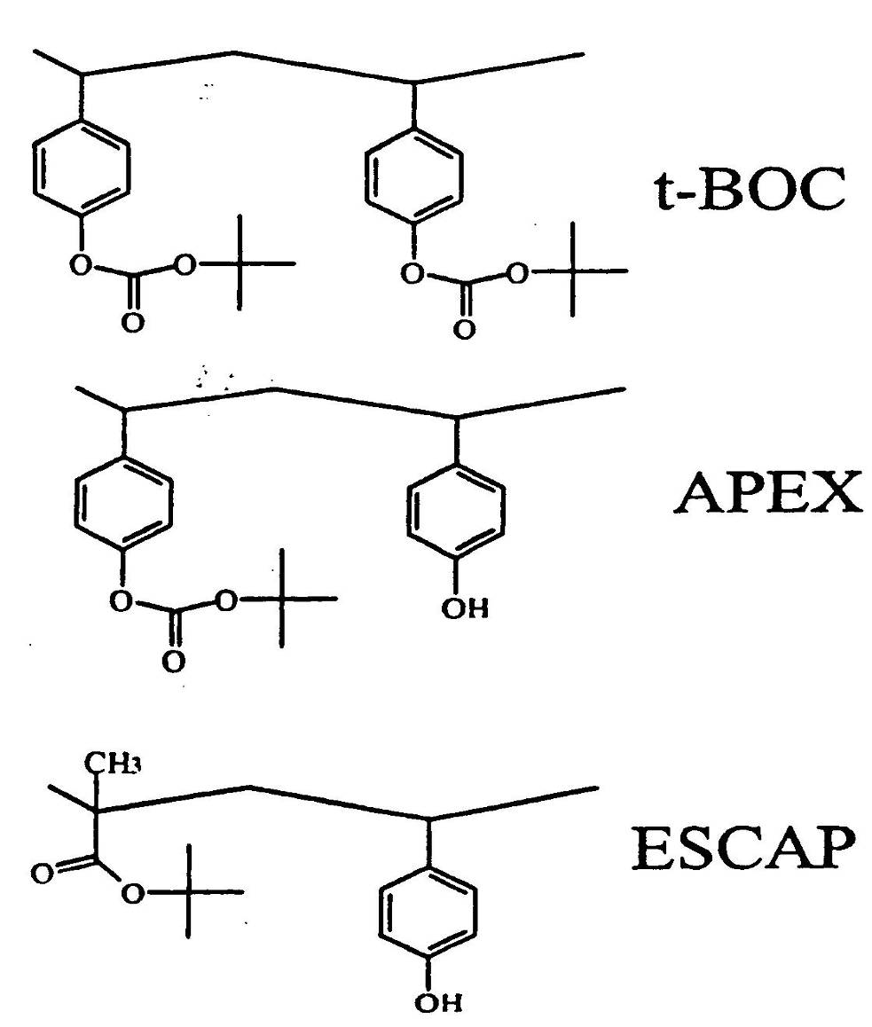
The “Family” of DUV Resists

Slide 7
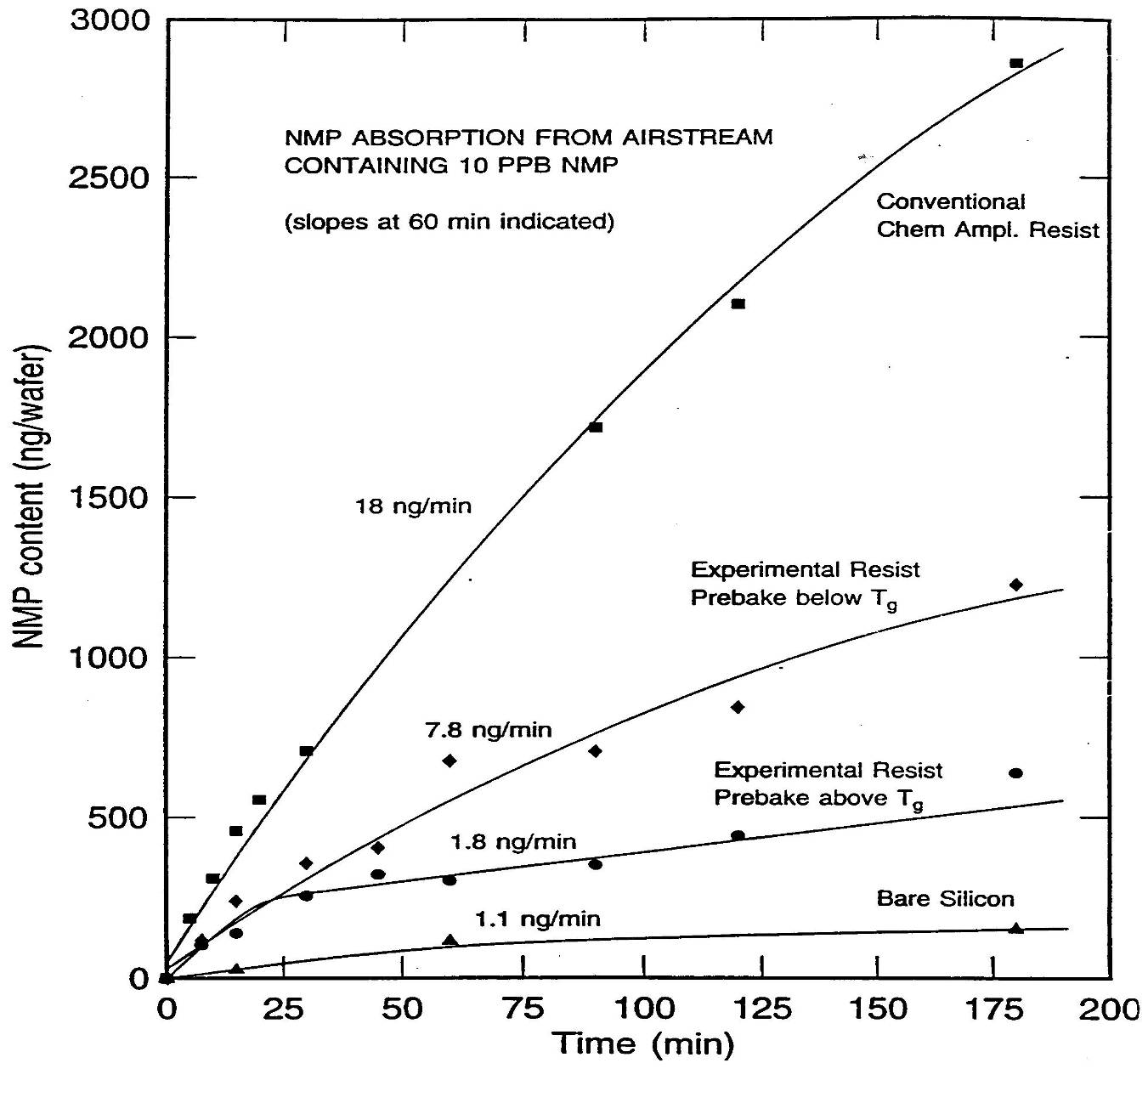

Slide 8
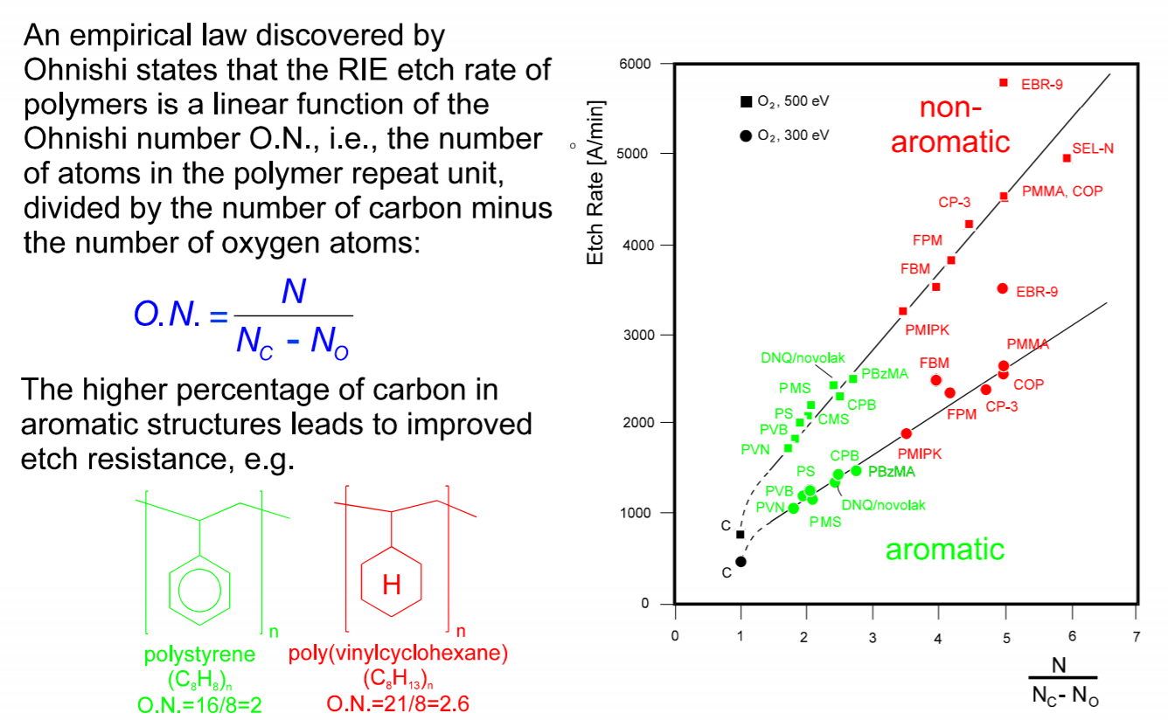
The Ohnishi Number
Watanabe, F. and Ohnishi, Y., J. Vac. Soc. Technol. B,422 (1986)

Slide 9
Resist and Process Development
Basic
Chemistry
Formulation and Process Development
Optimization
Performance
Time

Slide 10
Fujitsu’s Acrylic Platform
Acrylate Copolymers …
Free radical polymerizations
No metal

Slide 11
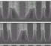
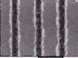
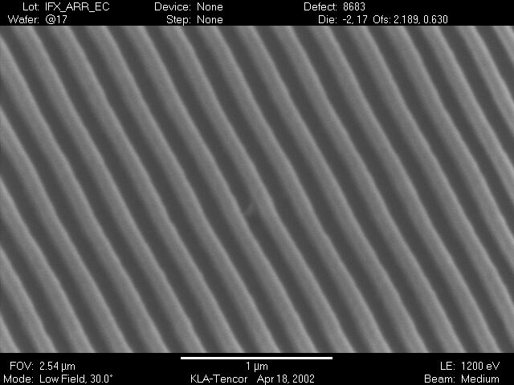
193nm Resist Challenges
Pattern Collapse
Line Edge Roughness (LER)
Etch Resistance
Heisenberg Principle issue
New Defect Types
Pattern Collapse
μ Bridging
LER

Slide 12
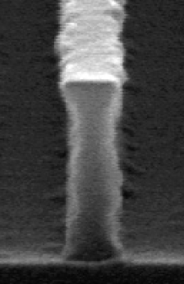
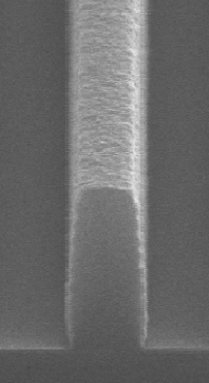
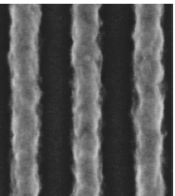
Line edge Roughness
193
248

Slide 13
Intrinsic limitation?
hν
mask
Generation of chemically stable catalyst
Exposure
PEB
Solubility-switching
plus transport
Diffusion Bias sets the limit at ~ 30-50nm

Slide 14
The Sandwich Experiment
FTIR
Normalized FTIR
Peak at 1760 cm⁻¹
Acid Detector Layer
To test
+t
Acid Feeder Layer
Mirror-backed Si wafer
Bake Plate

Slide 15
Initial PHOST Trilayer Experiments (~ 100 ºC)
Control
24 hrs
Acid
Many, many variations on this experiment were tried with similar results

Slide 16
Temperature Dependence of Diffusion in a Polymer Film
Nonaflic Acid Transit Time through 150nm PEMA vs. Temperature
Glass Transition Region
40000
30000
Tg = 70 ºC
Transit Time (seconds)
20000
10000
0
50
55
60
65
70
75
80
85
90
95
100
Temperature (ºC)
D ∝ L²/t

Slide 17
Fickian Diffusion Above Polymer Tg
D = 3x10⁻⁴ μm²/s

Slide 18
Acid Diffusion in PHOST
Transit Time vs T_{bake}
Summary Table*
T_{g} = 170 ºC
T (Cº)
D (μm²/s)
Method
185
1.0 x10⁻³
direct measure
180
2.6 x10⁻⁴
direct measure
175
8.7 x10⁻⁵
direct measure
170
2.6 x10⁻⁵
direct measure
165
6.5 x10⁻⁶
direct measure
150
1.6 x10⁻⁷
extrapolation
140
1.3 x10⁻⁸
extrapolation!
*Values For Nonaflic Acid in PHOST

Slide 19
Reaction Front Propagation Hypothesis
Initial Condition
High acid concentration region
Reaction zone
Reacted region (Bias region)
Unreacted region
Ignition of Reaction Front
- Active (mobile) acid molecules
- Inactive (immobile) acid molecules
Gradual Depletion of Front

Slide 20
Bilayer Experiment’s relations to the Sidewall
UV
Acid diffuses from exposed into unexposed regions
Exposure creats a latent image of photgenerated acid
…If a sidewall is isolated and the wafer is rotated 90º…
and everything outside the dotted box is ignored…
…it can be seen that the bilayer structure is just a rotated, isolated sidewall

Slide 21
The t-BOC Bilayer Experiment
FTIR
Normalized FTIR
Peak at 1760 cm⁻¹
Acid Detector Layer
+t
Acid Feeder Layer
Mirror-backed Si wafer
Bake Plate
Unexposed
Unexposed
Exposed

Slide 22
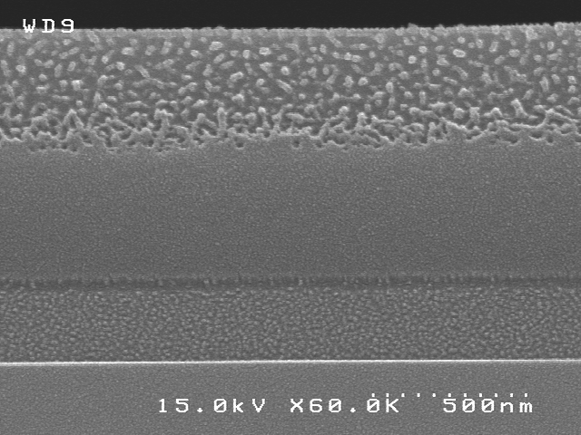
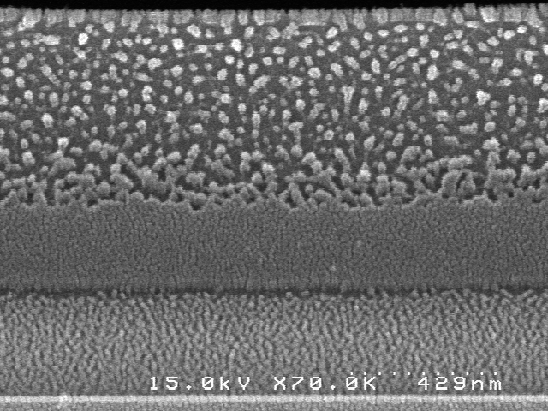
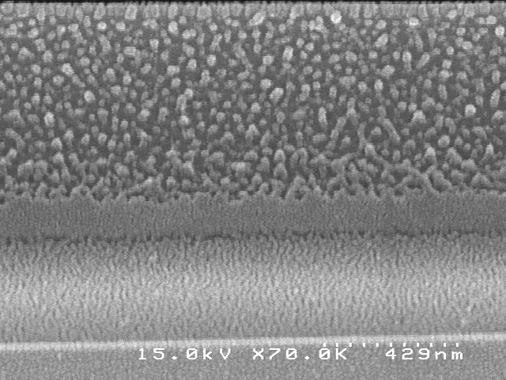
SEM of bilayer interface
SEM was used to investigate the interface between the acid feeder and acid detector layers after a 35 minute bake.
The reacted region appears as a well-defined intermediate layer between the original two layers.
ACID DETECTOR LAYER
INTERMEDIATE LAYER
ACID FEEDER LAYER
T_{bake} = 60 °C
130 nm
T_{bake} = 75 °C
230 nm
T_{bake} = 90 °C
415 nm
(Stewart et al., Proc. SPIE, 2000)

Slide 23
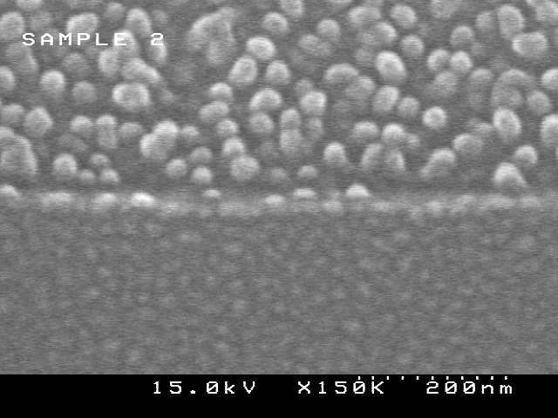
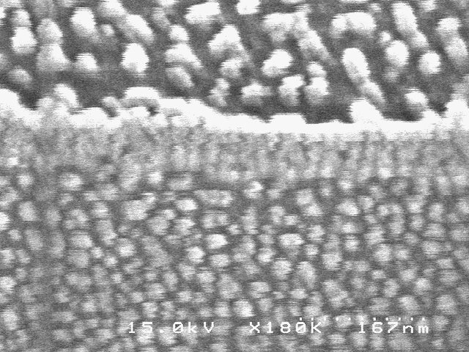
3. SEM of bilayer interface: control experiment
Two bilayer samples were prepared identically, except that one was exposed with UV light and the other was unexposed.
The unexposed sample (no acid) has a distinct interface between the two layers, while the exposed sample has formed an intermediate layer.
Without Acid
With Acid
Detector Layer
Intermediate
Layer
Feeder Layer
(Stewart et al., Proc. SPIE, 2000)

Slide 24
Bilayer Experimental Results
Fast Diffusion Region
Slow Diffusion Region
Bias

Slide 25
Bilayer Experiments
Bias
110 ºC
100 ºC
90 ºC
75º C

Slide 26
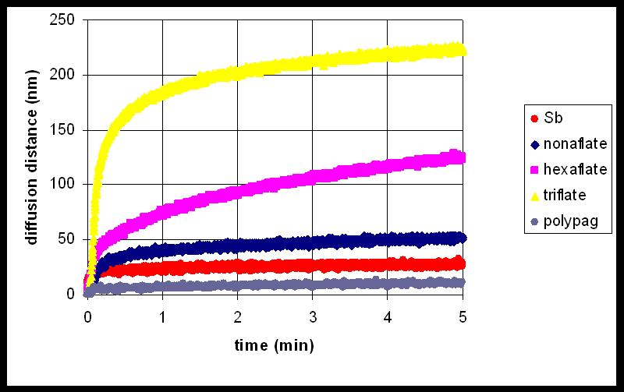
Effect of Counterion Size on Bias
~15nm

Slide 27
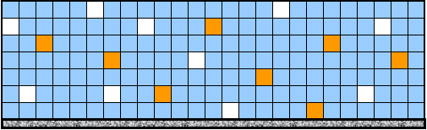

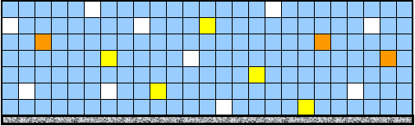
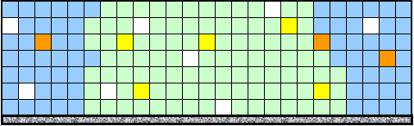
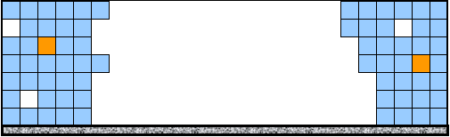
Monte Carlo Lattice Modeling
1. Film Creation
(Ch. 2 & 3)
2. Exposure
(Ch. 4)
3. Post Exposure Bake
(Ch. 5)
4. Develop
(Ch. 6 & Appendix)

Slide 28
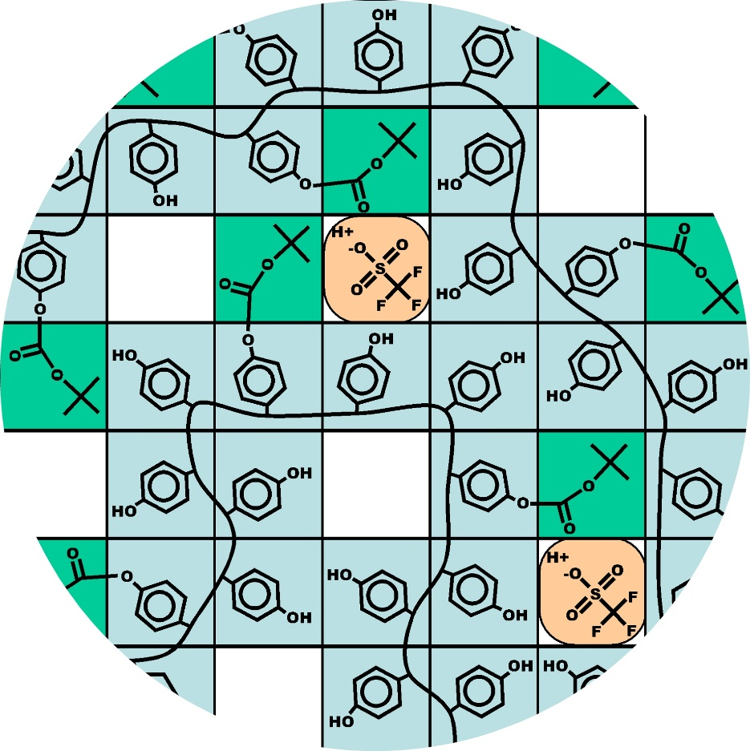
Mesoscale Monte Carlo simulation
Resist components are represented as cells in a three dimensional lattice.
Polymer molecules are represented as a string of cells, where each cell represents a repeat unit.
Other lattice cells contain PAG, photoproducts, solvent, free volume, etc.
Each type of cell behaves differently in accordance with its chemical identity during a dynamic Monte Carlo simulation.

Slide 29
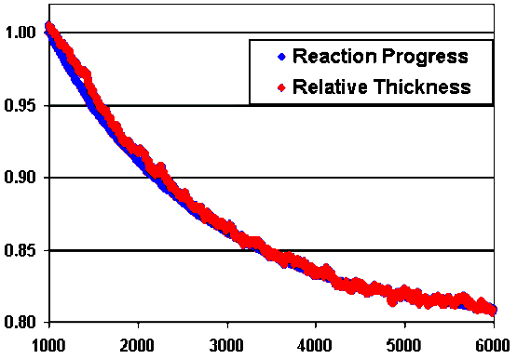
Post Exposure Bake: Reaction and Shrinkage
Single layer photoresist film:
Reaction progress and film thickness are tracked simultaneously.
ELLIPSOMETRY
FTIR
BAKE PLATE
Experimental results
Preliminary simulation results
Simulation Time
(Burns, Schmid et al., Proc. Int. Conf. on Photopolymers, 2000)

Slide 30
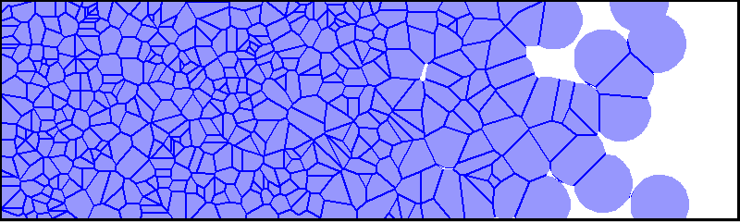
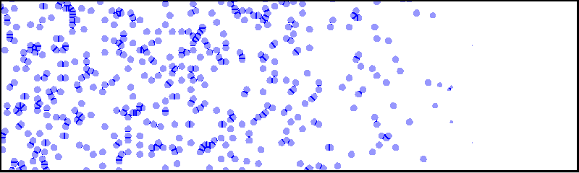
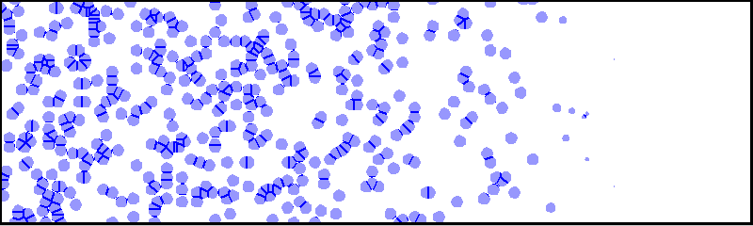
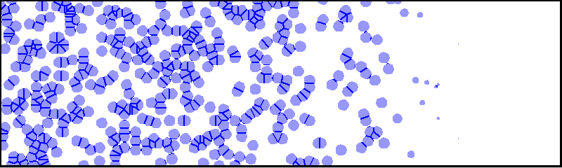
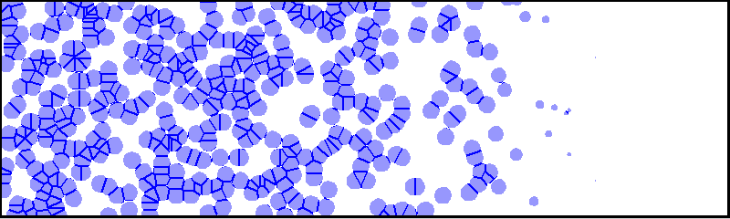
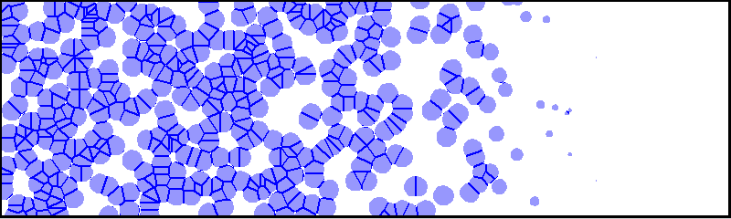
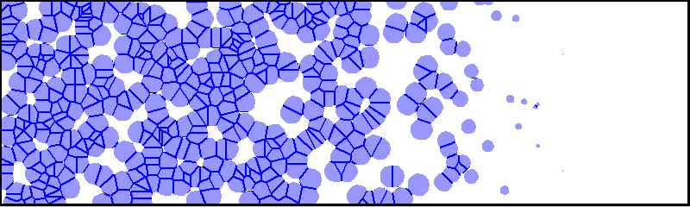
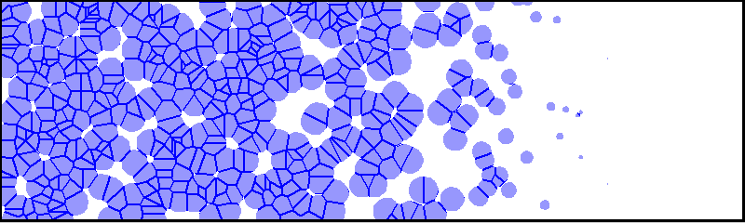
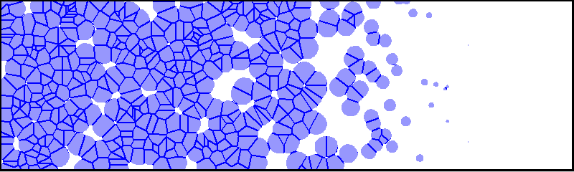

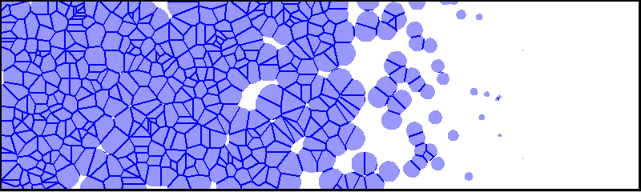
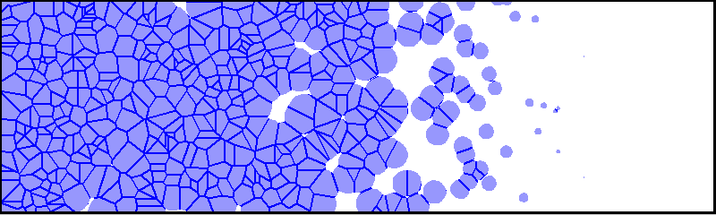
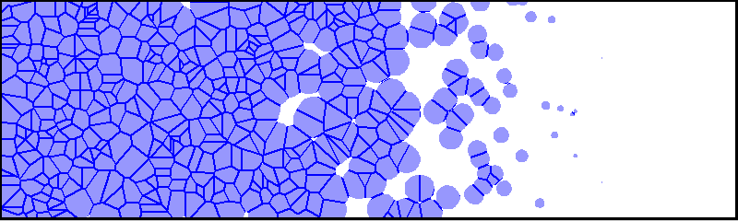
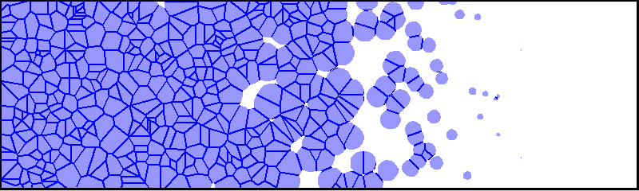
Influence of Base on LER
Base quencher can decrease the acid sphere of influence in low contrast regions, thereby reducing LER.
I(x)
Acid
Base
x
No base
With base
J. E. Meiring, T. B. Michaelson, G. M. Schmid and C. G. Willson, Proc. SPIE, 5753(2005), to be published

Slide 31
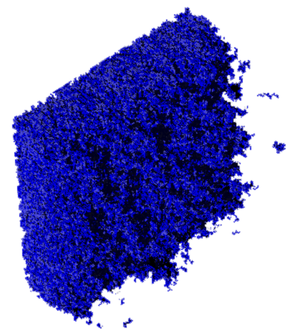

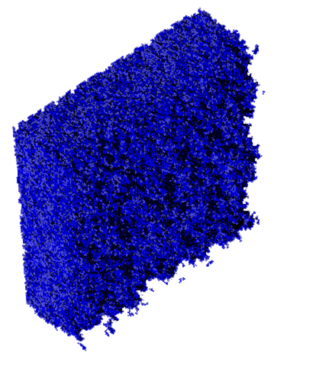
Exploring Base Effects
To add base quencher seems to make the contrast higher, thereby LER reducing.
I(x)
x
x
x
0% base
15% base
30% base
6.61 nm RMS
5.47 nm RMS
3.89 nm RMS
J. E. Meiring, T. B. Michaelson, G. M. Schmid and C. G. Willson, Proc. SPIE, 5753(2005), to be published

Slide 32


The good news is:
Intrinsic bias can be reduced by adding base
The bad news is:
a) This reduces the resist sensitivity very much

Slide 33
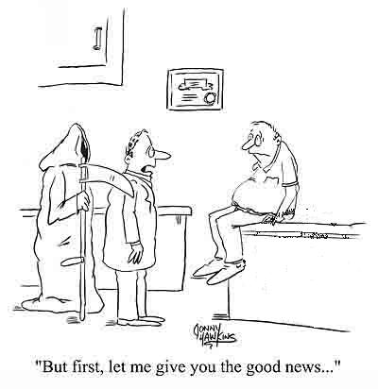
The Big Trade Off

